Slide 1
Image Classification
Capstone Project 2
(Final Presentation)

Slide 2
Real World Use
1 By self driving cars for classifying road signs
2 By supermarkets to keep real time count of stock
3 By Govt to see if people are wearing mask or not
4 In medical industry for classifying healthy and unhealthy cells

Slide 3
Data Acquisition
The data set was collected from here. They were collected by Alex Krizhevsky, Vinod Nair, and Geoffrey Hinton (credit).
The CIFAR-10 dataset consists of 60000 32x32 colour images in 10 classes, with 6000 images per class. There are 50000 training images and 10000 test images.

Slide 4

Data Cleaning
All the images are of 32 * 32 pixels. So not much cleaning is required
Here's the look of a image

Slide 5
Deep Learning models used
1 Basic CNN
2 Keras Tuner
3 Transfer Learning
4 Image Generation

Slide 6
How CNN’s work (briefly)
-1
-1
+1
+1
-1
-1
-1
+1
-1
-1
+1
-1
+1
-1
-1
-1
-1
+1
-1
-1
-1
-1
-1
-1
-1
-1
-1
-1
-1
-1
-1
-1
-1
-1
-1
-1
-1
-1
-1
+1
-1
-1
-1
-1
-1
-1
+1
+1
+1
+1
+1
-1
-1
-1
-1
-1
-1
-1
-1
+1
-1
-1
-1
+1
+1
-1
+1
-1
-1
-1
-1
+1
-1
+1
-1
-1
+1
-1
-1
+1
-1
+1
-1
-1
+1
+1
-1
-1
-1
-1
-1
-1
+1
-1
-1
-1
+1
-1
-1
-1
-1
-1
+1
+1
+1
-1
-1
-1
+1
+1
+1
+1
+1
+1
-1
-1
-1
-1
-1
-1
-1
-1
-1
-1
-1
-1
-1
-1
-1
-1
-1
-1
-1
-1
-1
-1
-1
-1
-1
-1
-1
-1
-1
-1
+1
+1
+1
-1
-1
-1
-1
-1
-1

Slide 7
Filtering
+1
+1
+1
-1
-1
+1
+1
+1
+1
1+1+1+1+1+1+1+1+1
-1
+1
-1
+1
+1
+1
+1
-1
+1
-1
-1
+1
+1
-1
+1
9
-1
-1
-1
-1
-1
-1
-1
-1
-1
-1
-1
-1
-1
-1
-1
-1
-1
-1
-1
-1
+1
-1
-1
-1
+1
-1
+1
-1
+1
+1
+1
-1
-1
-1
-1
-1
-1
-1
+1
-1
-1
+1
-1
-1
-1
+1
-1
+1
-1
-1
+1
-1
-1
+1
-1
-1
-1
+1
-1
-1
-1
+1
-1
-1
-1
-1
-1
+1
+1
+1
-1
-1
-1
-1
-1
-1
-1
-1
-1
-1
-1
-1
-1
-1
-1
-1
-1
-1
-1
-1
-1

Slide 8
-0.11
0.55
0.22
0.22
-0.11
-0.11
-0.11
0.55
0.55
Image becomes a stack of images
0.55
0.22
0.55
0.11
-0.11
0.22
-0.11
0.55
-0.11
0.33
-0.11
-1
-1
+1
0.22
0.22
0.55
0.55
-0.11
0.22
0.11
+1
0.55
-0.11
0.55
0.22
0.55
+1
+1
-0.11
-0.11
0.55
-0.11
0.22
-1
+1
-1
-0.11
-0.11
-0.11
0.55
0.55
0.55
0.22
-0.11
.55
0.55
+1
-1
-1
0.22
0.55
0.55
0.22
+1
-0.11
0.55
0.22
0.22
-0.11
+1
0.55
0.22
0.11
-0.11
0.55
0.22
-0.11
-0.11
0.55
-1
-1
-1
-1
-1
-1
-1
-1
-1
-1
-1
-1
-1
-1
-1
-1
-1
-1
+1
-1
-1
-0.11
0.22
0.55
0.22
-0.11
0.22
0.55
0.22
0.22
-0.11
0.22
0.22
-0.11
0.22
-1
-1
-1
+1
+1
+1
-1
-1
-1
-1
+1
-1
0.55
0.22
0.55
-0.11
0.55
0.55
0.55
-1
-1
+1
-1
-1
-1
+1
-1
-1
-1
-1
+1
0.22
-0.11
0.55
0.55
-0.11
0.22
+1
0.22
0.55
0.55
-0.11
0.22
-0.11
0.55
-1
+1
-1
-1
+1
-1
-1
+1
-1
-0.11
0.55
-0.11
0.55
-0.11
0.22
-0.11
+1
-1
-1
-1
-1
-1
0.55
0.55
-0.11
0.22
0.22
0.55
0.22
-1
-1
+1
-1
-1
-1
+1
+1
+1
-1
-1
-1
-1
-1
-1
-1
-1
-1
-1
-1
-1
0.22
0.55
-0.11
0.22
0.55
0.22
0.55
-1
-1
-1
-1
-1
-1
-1
-1
-1
+1
+1
+1
0.22
-0.11
0.22
0.55
-0.11
0.55
-0.11
-1
-1
-1
0.55
0.22
0.55
0.22
0.22
-0.11
0.55
-1
-1
-1
0.22
-0.11
0.55
-0.11
0.55
0.55
0.22
-0.11
0.55
0.22
0.55
0.22
-0.11
0.22
0.22
-0.11
0.22
-0.11
0.55
-0.11
0.55
-0.11
0.22
0.22
0.55
-0.11
0.22
0.22
Here we get stack of filtered images

Slide 9
Pooling
Maximum
0.55
-0.11
0.55
0.22
0.22
-0.11
-0.11
-0.11
0.55
0.55
0.55
0.22
0.55
0.11
-0.11
0.22
-0.11
0.55
-0.11
0.33
-0.11
0.22
0.22
0.55
0.55
-0.11
0.22
0.11
+1
0.55
-0.11
0.55
0.22
0.55
+1
+1
-0.11
-0.11
0.55
-0.11
0.22
-0.11
-0.11
-0.11
0.55
0.55
0.55
0.22
-0.11
.55
0.55
0.22
0.55
0.55
0.22
+1
-0.11
0.55
0.22
0.22
-0.11
+1
0.55
0.22
0.11
-0.11
0.55
0.22
-0.11
-0.11
0.55

Slide 10
-0.11
0.55
0.22
-0.11
0.22
-0.11
-0.11
-0.11
0.55
0.55
0.55
0.22
0.55
0.55
-0.11
0.55
0.11
-0.11
0.22
-0.11
0.55
-0.11
0.33
-0.11
0.22
0.22
-0.11
-0.11
0.55
0.55
-0.11
0.55
0.22
0.22
0.11
+1
0.55
-0.11
0.55
0.22
0.55
+1
+1
-0.11
-0.11
0.55
-0.11
0.22
-0.11
-0.11
0.55
0.22
0.55
-0.11
-0.11
0.55
0.55
0.55
0.22
-0.11
.55
0.55
0.22
0.55
0.55
0.22
+1
-0.11
0.55
0.22
0.22
0.22
-0.11
0.55
0.22
-0.11
+1
0.55
0.22
0.11
-0.11
0.55
0.22
-0.11
-0.11
0.55
-0.11
0.22
0.55
0.22
-0.11
0.22
0.55
0.22
-0.11
0.55
0.55
0.22
0.22
-0.11
0.22
0.22
-0.11
0.22
0.22
0.55
0.55
-0.11
0.55
0.22
0.55
-0.11
0.55
0.55
0.55
0.22
-0.11
0.55
0.55
-0.11
0.22
+1
-0.11
0.55
-0.11
0.55
0.22
0.55
0.55
-0.11
0.22
-0.11
0.55
0.55
0.55
-0.11
0.22
-0.11
0.55
-0.11
0.55
-0.11
0.22
-0.11
0.55
0.55
-0.11
0.22
0.22
0.55
0.22
0.22
-0.11
0.55
-0.11
0.22
0.55
-0.11
0.22
0.55
0.22
0.55
-0.11
0.55
0.22
0.55
0.22
-0.11
0.22
0.55
-0.11
0.55
-0.11
0.55
0.22
0.55
0.22
0.22
-0.11
0.55
0.22
-0.11
0.22
-0.11
0.22
-0.11
0.55
-0.11
0.55
0.55
0.22
-0.11
0.22
0.22
0.55
-0.11
0.55
0.22
0.55
0.22
-0.11
0.22
0.22
-0.11
0.22
-0.11
0.55
-0.11
0.55
-0.11
0.22
0.22
0.55
-0.11
0.22
0.22

Slide 11
ReLUS
Changing all negative to zero
-0.11
-0.11
0
0.55
0.22
0.55
0.22
0.22
-0.11
-0.11
0.22
-0.11
-0.11
-0.11
0.55
0.55
0.55
-0.11
0.55
0.55
0.55
0.22
0.22
0
0.55
-0.11
0.11
0
0.55
-0.11
0.22
-0.11
0.55
0.11
-0.11
0.22
-0.11
0.55
-0.11
0.33
-0.11
0.33
-0.11
0.22
0.22
0.22
0
0.22
-0.11
0.55
-0.11
0.55
0.55
0
0.55
0.22
0.11
+1
0
0.55
0.55
-0.11
0.22
0.11
+1
0.55
-0.11
0.55
0.22
0.22
0.55
0
+1
-0.11
-0.11
0.55
+1
-0.11
0.22
0.55
+1
+1
-0.11
0
-0.11
-0.11
0.55
-0.11
0.22
0
-0.11
-0.11
-0.11
-0.11
-0.11
0
0.55
0.55
0.55
0.55
0.22
-0.11
.55
0.55
0.55
0.55
0
0.22
-0.11
.55
0.55
0.55
0.22
0.55
0.55
0.22
+1
0.22
0.55
0.22
+1
-0.11
-0.11
0.55
0.22
0.22
0.55
0.22
0.22
-0.11
0.55
0
0
+1
-0.11
+1
0.55
0.22
0.11
0.55
0.22
0.11
0.22
-0.11
-0.11
0.22
-0.11
0.55
-0.11
-0.11
0.55
0
-0.11
0.55
0

Slide 12
-0.11
0.55
0.22
0.22
-0.11
-0.11
-0.11
0.55
0.55
0.55
0.22
-0.11
0
0.55
0.22
0.22
-0.11
-0.11
-0.11
0.55
0.55
0.55
0.11
-0.11
0.55
0.22
-0.11
0.55
0.22
-0.11
0.33
-0.11
0.22
0.22
0.55
0.55
-0.11
0.22
0.11
+1
0.55
-0.11
0.55
0.22
0
0.55
-0.11
0.11
0
0.22
-0.11
0.55
-0.11
0.33
-0.11
0.22
0
0.22
0.55
+1
+1
-0.11
-0.11
0.55
-0.11
0.22
-0.11
-0.11
0.55
-0.11
0.55
0
0.22
0.11
+1
0
0.55
0.55
-0.11
-0.11
0.55
0.55
0.55
0.22
0.22
-0.11
.55
0.55
0.55
0
+1
-0.11
-0.11
0.55
+1
-0.11
0.22
-0.11
0
0.22
0.55
0.55
0.22
+1
0
-0.11
-0.11
0.55
0.22
0.22
-0.11
0
0.55
0.55
0.55
0.22
-0.11
.55
0.55
-0.11
+1
0.55
0
0.22
0.11
-0.11
0.55
0.22
-0.11
-0.11
0.55
0.22
0.55
0.55
0.22
+1
-0.11
0.55
0.22
0.22
-0.11
0.55
0
0
+1
0.22
0.11
-0.11
0.55
0.22
-0.11
0.55
0
-0.11
0
-0.11
0.22
0.55
0.22
-0.11
0.22
0.55
0
0
0.55
0.22
0.22
-0.11
0.22
0.22
-0.11
0.22
-0.11
0.22
0.55
0.22
-0.11
0.22
-0.11
0
0.55
0.22
0.55
-0.11
0.55
0.55
0.55
0.22
0.22
0
0.22
0.22
-0.11
0.22
0.55
0
0.22
-0.11
0.55
0.55
-0.11
0.22
+1
0.55
0.22
-0.11
0.55
0.55
0.55
-0.11
0.55
0
+1
0.22
0.55
0.55
-0.11
0.22
-0.11
0.55
0.22
0
0.55
-0.11
0.22
-0.11
0
0.55
-0.11
0.55
-0.11
0.55
-0.11
0.22
-0.11
0.22
0.55
0.55
0
0.22
-0.11
0
0
-0.11
0.55
0.55
-0.11
0.22
-0.11
-0.11
0
0.55
0.55
-0.11
0.22
0.22
0.55
0.22
0
0.55
0.55
-0.11
0.22
0.22
0.55
0.22
0
0.22
0.55
-0.11
0.22
0.55
0.22
0.55
0.22
0.55
-0.11
0.22
0.55
0.22
0.55
0
0.22
-0.11
0.22
0.55
-0.11
0.55
-0.11
0.22
-0.11
0.22
0.55
-0.11
0.55
-0.11
0
0
0
0.55
0.22
0.55
0.22
0.22
-0.11
0.55
0.55
0.22
0.55
0.22
0.22
-0.11
0.55
0
0.22
-0.11
0.55
0
0.55
0.22
0.22
-0.11
0.55
-0.11
0.55
0.55
0.22
0
-0.11
0.55
-0.11
0.55
0.22
0.55
0.22
-0.11
0.22
-0.11
0.55
0.22
0.55
0.22
-0.11
0.22
0
0
0.22
0
0.22
0.55
0.55
-0.11
-0.11
-0.11
0.22
-0.11
0.22
-0.11
0.55
-0.11
0.55
0
0
-0.11
0.22
0.22
0.55
-0.11
0.22
-0.11
0.22
0.22
0.55
-0.11
0.22
0.22
0
0
0.22

Slide 13
C
O
N
V
o
L
U
T
I
O
n
C
O
N
V
o
L
U
T
I
O
n
M
A
X
P
O
O
L
I
N
G
M
A
X
P
O
O
L
I
N
G
0.55
-0.11
0.55
0.22
R
E
L
u
R
E
L
u
-1
-1
-1
-1
-1
-1
-1
-1
-1
-1
-1
-1
-1
-1
-1
-1
-1
-1
-1
-1
-1
+1
+1
+1
-1
-1
-1
-1
-1
+1
-1
-1
-1
+1
-1
-1
-1
-1
-0.11
0.55
-1
+1
+1
-1
-1
+1
-1
+1
-1
-1
-1
+1
-1
-1
-0.11
0.22
-1
-1
-1
-1
-1
+1
+1
+1
-1
-1
-1
-1
-1
-1
-1
-1
-1
-1
-1
-1
-1
-1
-1
-1
-1
-1
-1
-1
-1
0.22
-0.11
0.22
0.55

Slide 14
For unknown Input
0.55
-0.11
0.55
0.9
0.22
-0.11
0.55
-0.11
0.22
0.22
0.5
-0.11
0.22
0.55

Slide 15
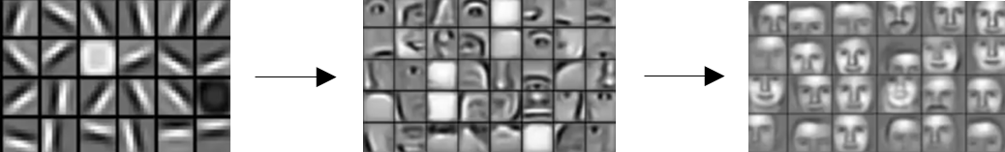
0
0
1
0
0
1
1
1
1
0
0
0
1

Slide 16
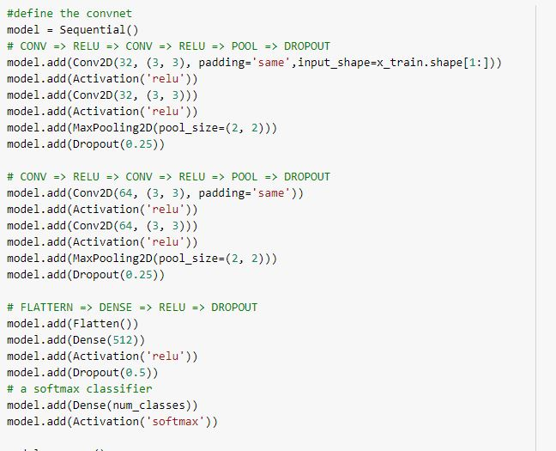
1 Basic CNN
1 Architecture
2 Accuracy -- 74%

Slide 17
2 Keras Tuner
Keras tuner is a library that helps pick optimal set of hyperparameters parameters for CNNs.

Slide 18
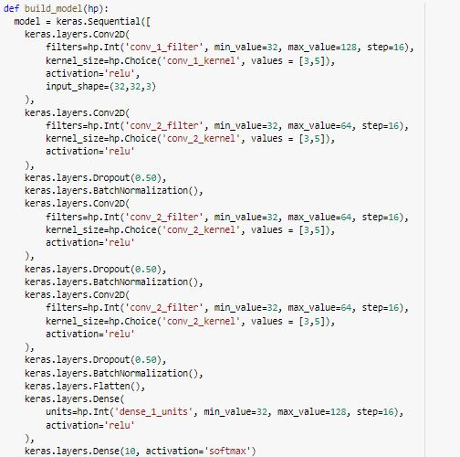
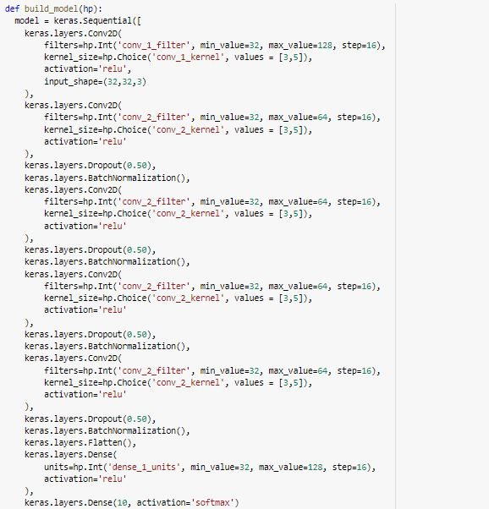
Architecture
Accuracy 76.44 % 64%

Slide 19
3 Transfer Learning
Transfer learning is a research problem in ML that focuses on storing knowledge (weights) gained while solving one problem and applying it to different but related problem

Slide 20
0
0
1
0
0
1
1
1
1
0
0
0
1
-----------
Input layer
------------------
Output Layer
------------------------
Hidden Layers
For simplicity weights are only 0 and 1 for demonstration
Assume all the weights are assigned.

Slide 21
0
0
0
1
0
0
0
1
1
1
1
1
0
0
0
0
-----------
Input layer
------------------------
Hidden Layers (pre trained model)
------------------
Custom Layers
-------------
Output Layer
For simplicity weights are only 0 and 1 for demonstration
Assume all the weights are assigned.

Slide 22
Pre Trained Models Used
A ResNet50
B VGG 16
C InceptionV3

Slide 23
PT Model Comparison
 | Parameters (millions) | Parameters after adding more layer (millions) | Train time (approx hour, run on GPU) | Accuracy (%)
ResNet50 | 23.5 | 40.9 | 2.5 hrs | 92.40
VGG16 | 14.7 | 19.05 | 2.5 hrs | 55.24
Inception V3 | 21.8 | 31.5 | 1.75 hrs | 95.10

Slide 24
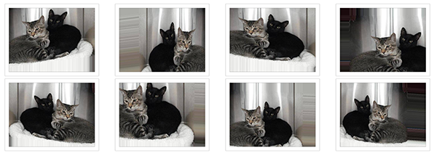
4 Image Generation
Image generation means to manipulate image rg flipping, zooming, rotation etc
Generally used for small datasets.

Slide 25
Comparison
Models |  | Accuracy(%)
Keras Tuner | With 6 CNN layers | 64.00
 | With 5 CNN layers | 76.44
Transfer Learning | ResNet50 | 92.40
 | VGG16 | 55.24
 | Inception V3 | 95.10
Image Generation | Basic CNN | 85.00
 | With transfer learning | overfitted

Slide 26
THANK YOU

